Slide 1
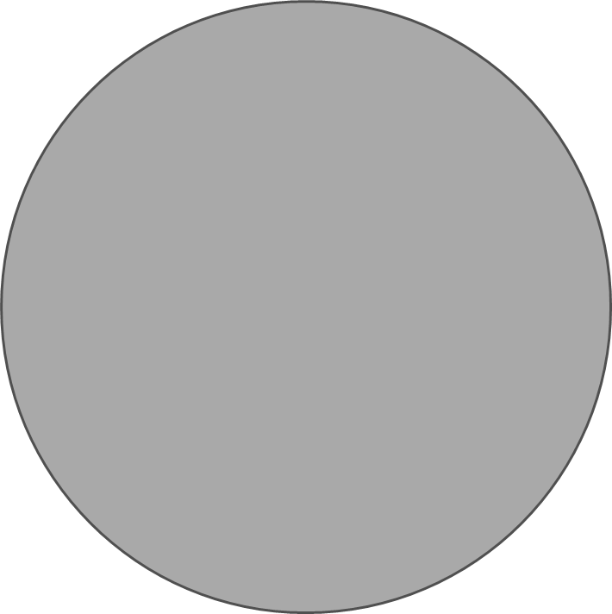
long-suffering
people
PRODUCT
PRODUCT
affordable
useful
money
work

Slide 2
Screen issue

Slide 3
Heal your screen

Slide 4
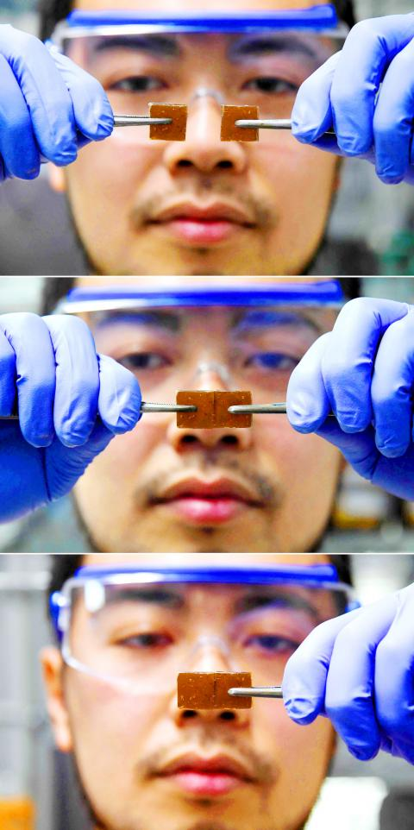
polyether-thioureas
can heal itself from cracks and breaks when pressed together by hand
no heat needed
the first hard substance of its kind that can be healed at room temperature
Yu Yanagisawa

Slide 5


Slide 6
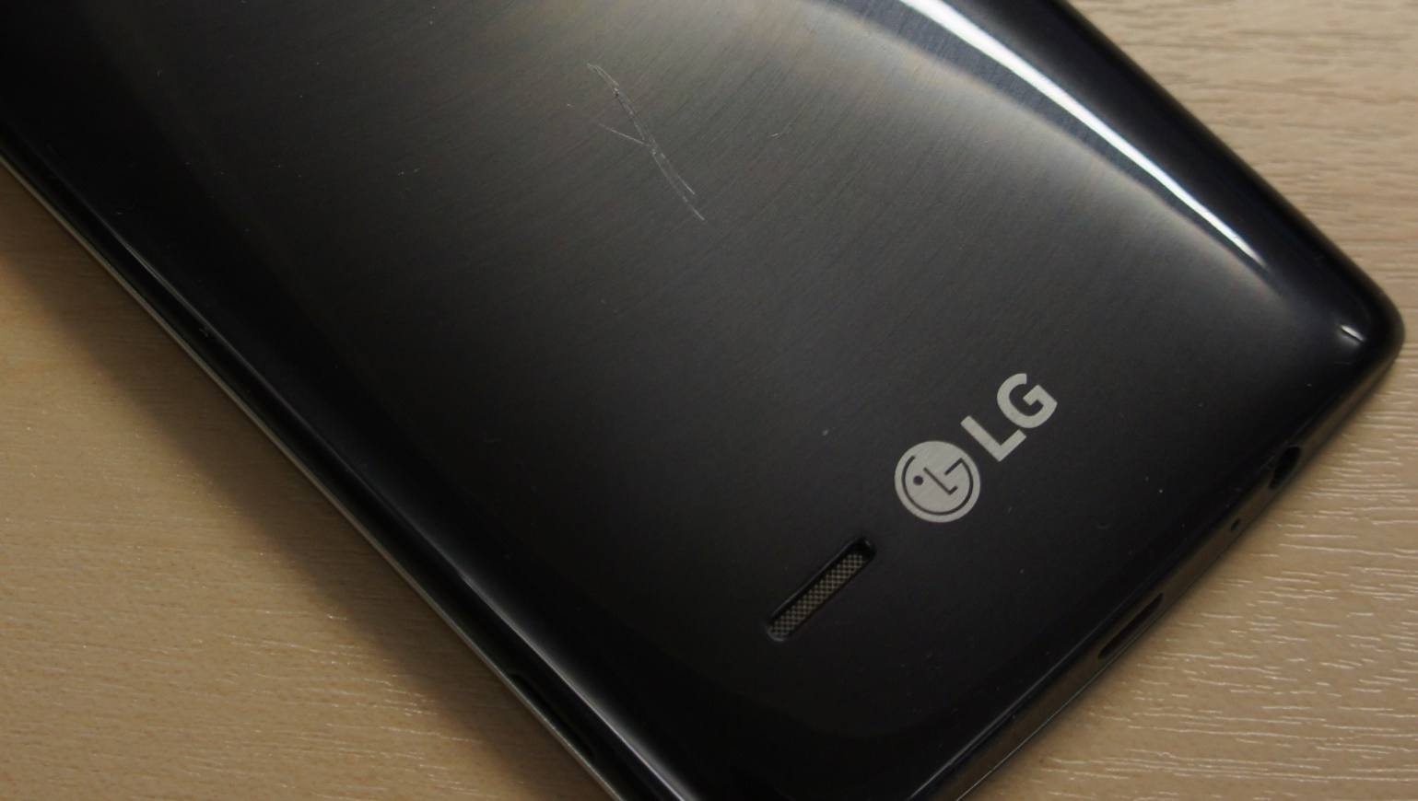
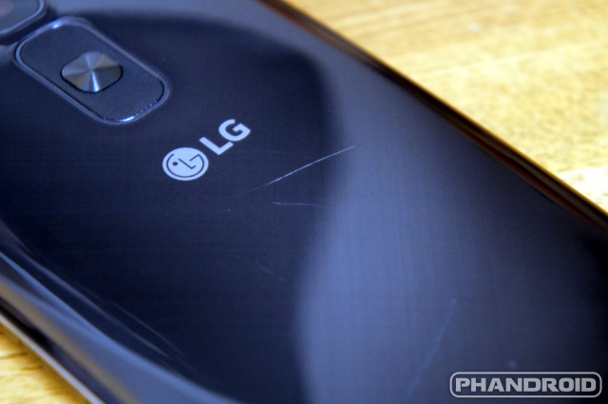
LG’s G Flex 2 idea improvement
shipped in 2015 with a coating on its back that was capable of healing minor scratches over time
failed to completely repair heavier damage ☹

Slide 7
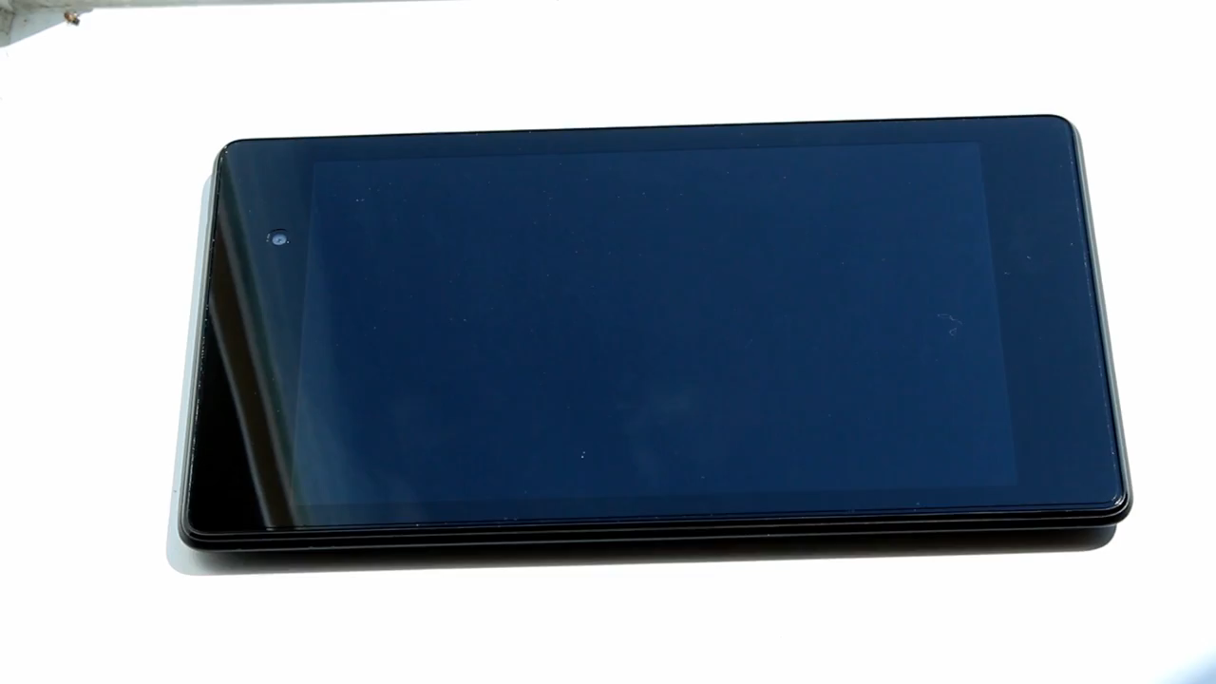

Slide 8
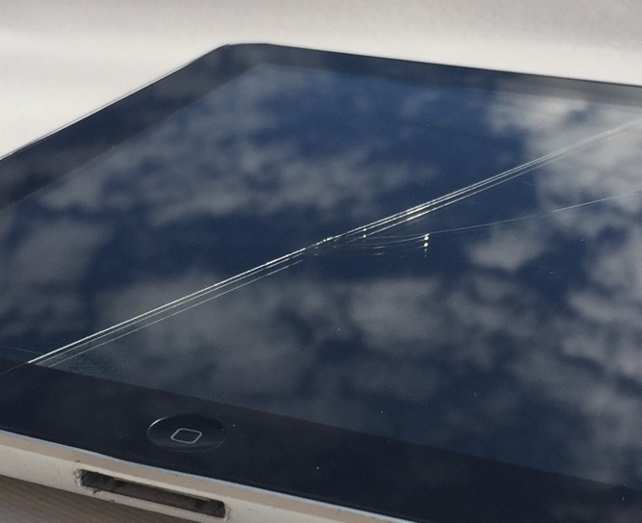
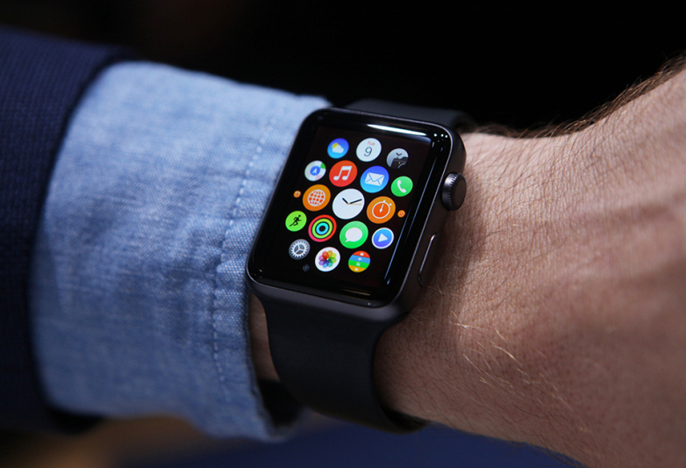
Wide range of applications

Slide 9
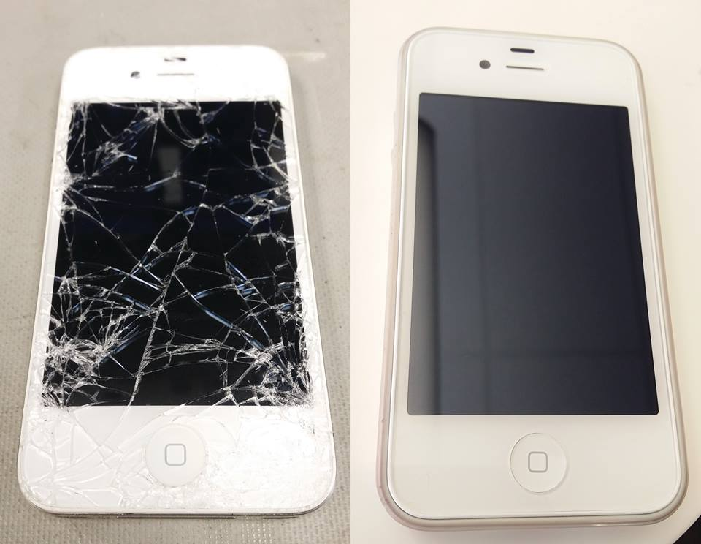
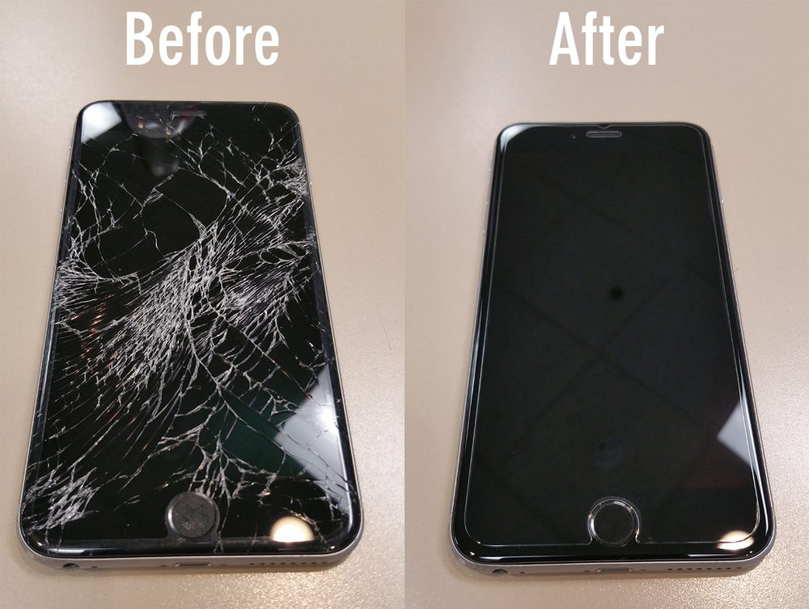
"The future starts today" ~Pope John Paul II

